Slide 1


Day 12
Math24 (Differential Equations)
Ch 2.6 Exact Equations and Integrating Factors (Page 95-102)
Elementary Differential Equations and Boundary Value Problems, 10th edition, by William E. Boyce and Richard C. DiPrima, ©2013 by John Wiley & Sons, Inc.

Slide 2


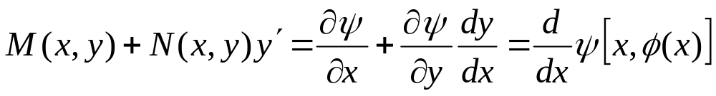
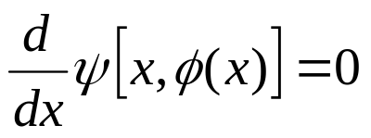
Consider a first order ODE of the form
Suppose there is a function ψ such that
and such that ψ(x,y) = c defines y = φ(x) implicitly. Then
and hence the original ODE becomes
Thus ψ(x,y) = c defines a solution implicitly.
In this case, the ODE is said to be exact.

Slide 3

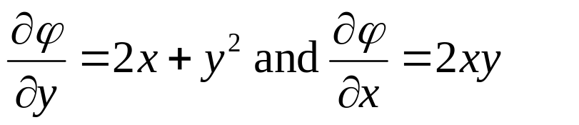

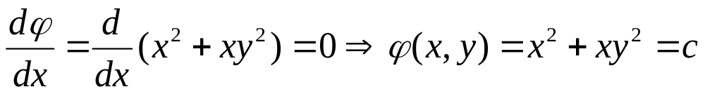
Example 1: Exact Equation
Consider the equation:
It is neither linear nor separable, but there is a function φ such that
The function that works is
Thinking of y as a function of x and calling upon the chain rule, the differential equation and its solution become

Slide 4

Theorem 2.6.1
Suppose an ODE can be written in the form
where the functions M, N, M_{y} and N_{x} are all continuous in the rectangular region R: (x, y) ∈ (α, β ) x (γ, δ ). Then Eq. (1) is an exact differential equation iff
That is, there exists a function ψ satisfying the conditions
if M and N satisfy Equation (2).

Slide 5
Example 2: Exact Equation (1 of 3)
Consider the following differential equation.
Then
and hence
From Theorem 2.6.1,
Thus

Slide 6
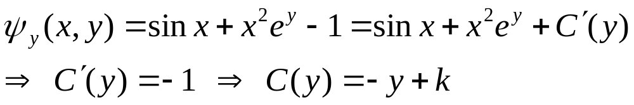


Example 2: Solution (2 of 3)
We have
and
It follows that
Thus
By Theorem 2.6.1, the solution is given implicitly by

Slide 7
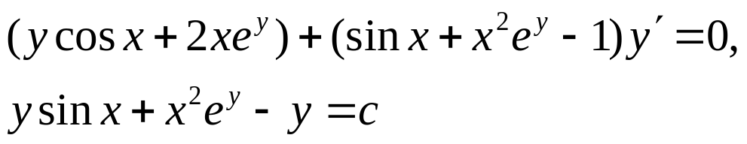
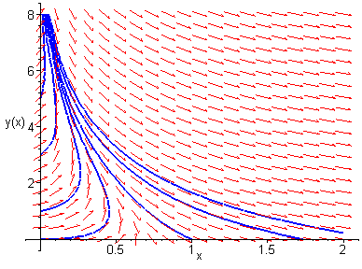
Example 2:
Direction Field and Solution Curves (3 of 3)
Our differential equation and solutions are given by
A graph of the direction field for this differential equation,
along with several solution curves, is given below.

Slide 8

Example 3: Non-Exact Equation (1 of 2)
Consider the following differential equation.
Then
and hence
To show that our differential equation cannot be solved by this method, let us seek a function ψ such that
Thus

Slide 9
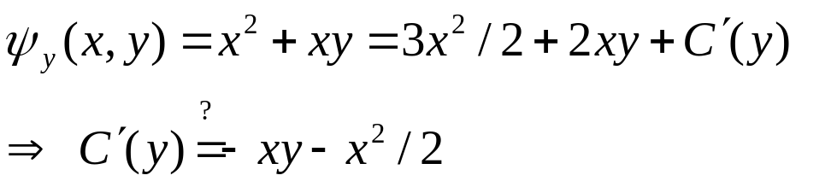
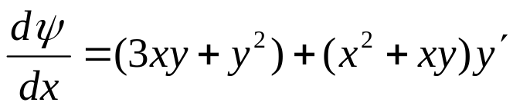
Example 3: Non-Exact Equation (2 of 2)
We seek ψ such that
and
Then
Because C’(y) depends on x as well as y, there is no such function ψ(x, y) such that

Slide 10
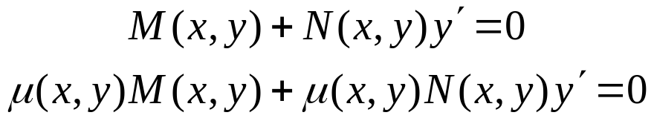
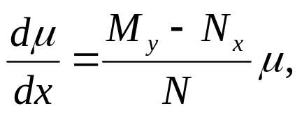
Integrating Factors
It is sometimes possible to convert a differential equation that is not exact into an exact equation by multiplying the equation by a suitable integrating factor μ(x, y):
For this equation to be exact, we need
This partial differential equation may be difficult to solve. If μ is a function of x alone, then μ_{y} = 0 and hence we solve
provided right side is a function of x only. Similarly if μ is a function of y alone. See text for more details.

Slide 11

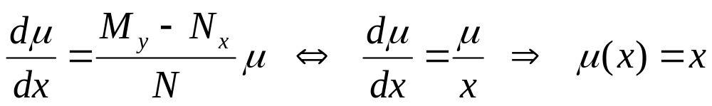

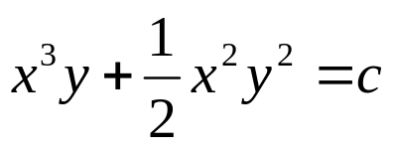
Example 4: Non-Exact Equation
Consider the following non-exact differential equation.
Seeking an integrating factor, we solve the linear equation
Multiplying our differential equation by μ, we obtain the exact equation
which has its solutions given implicitly by

